Slide 1
Credit Risk Assessment Tool

Slide 2
Data Generation
Faker Library - Generated 50,000 records based on business rules
Business Rules - Douglas to add

Slide 3
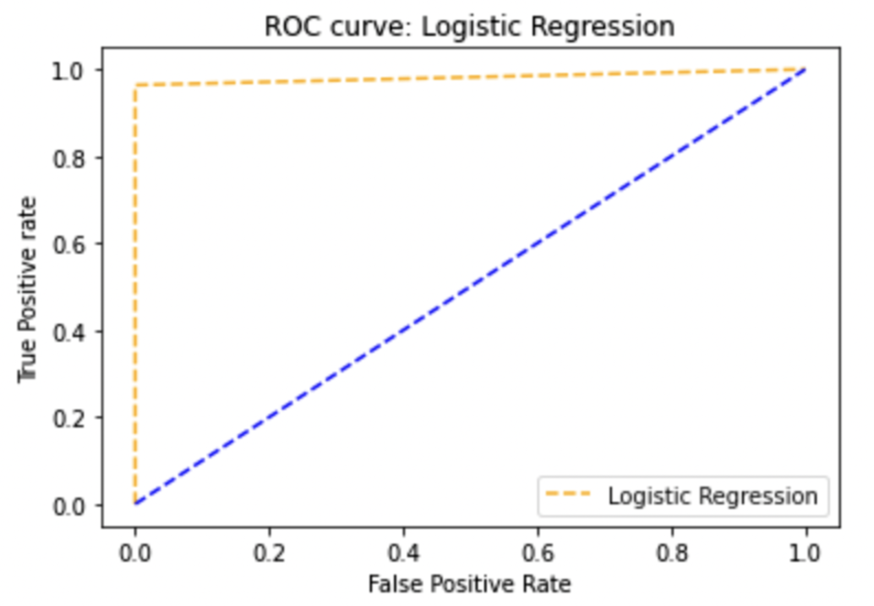
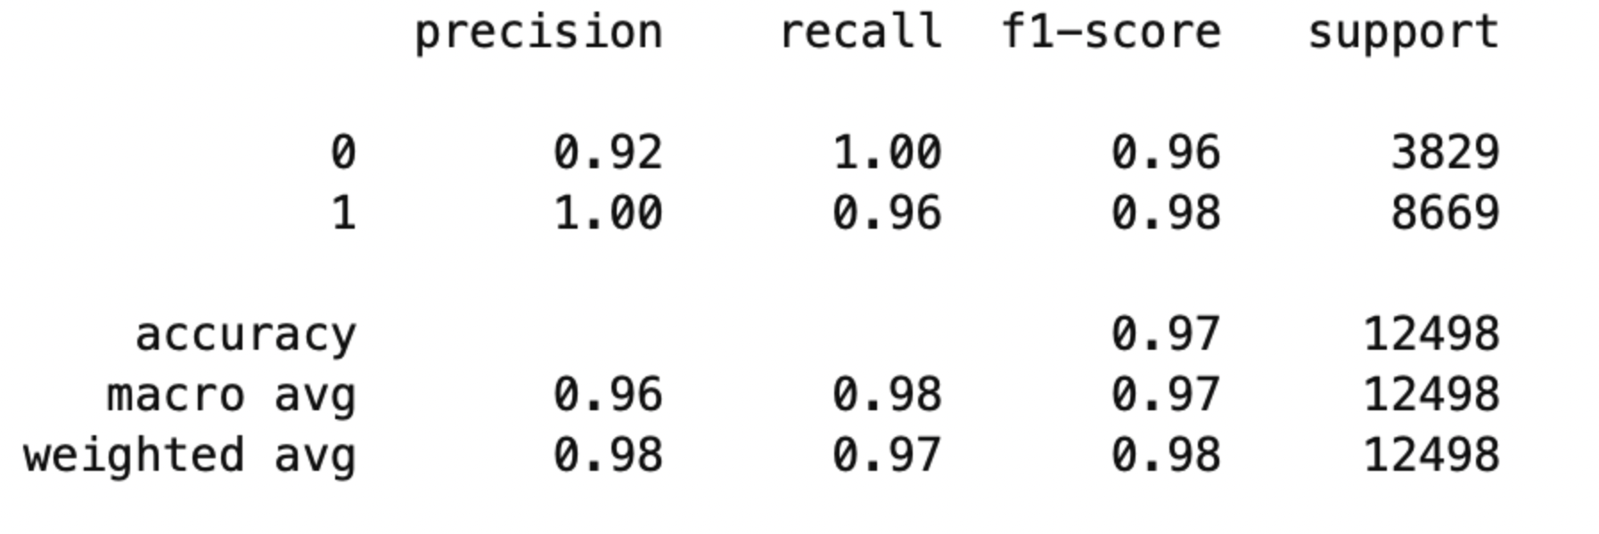
Machine Learning Algorithms
Logistic Regression

Slide 4
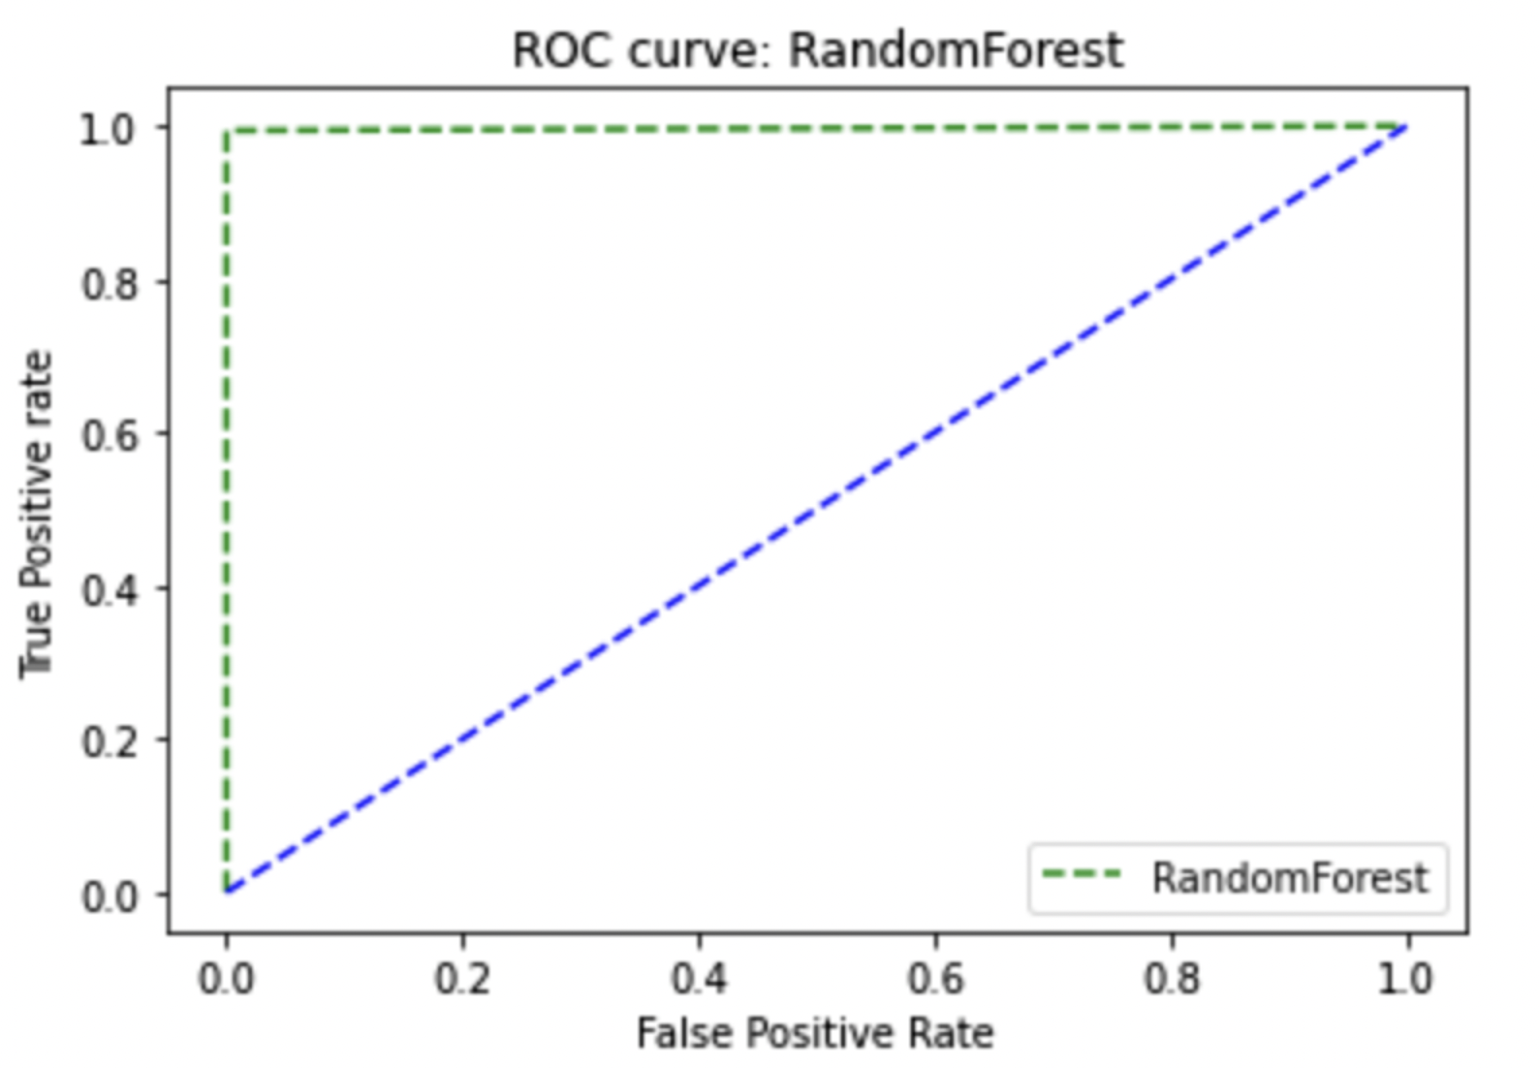
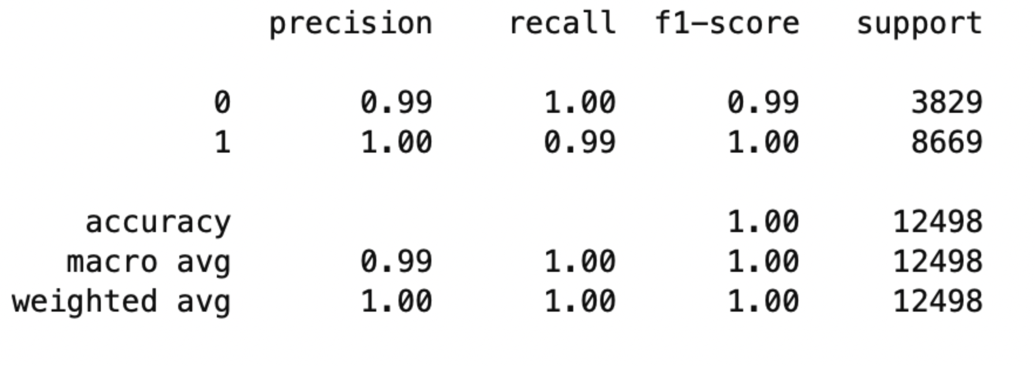
Machine Learning Algorithms
Random Forest

Slide 5
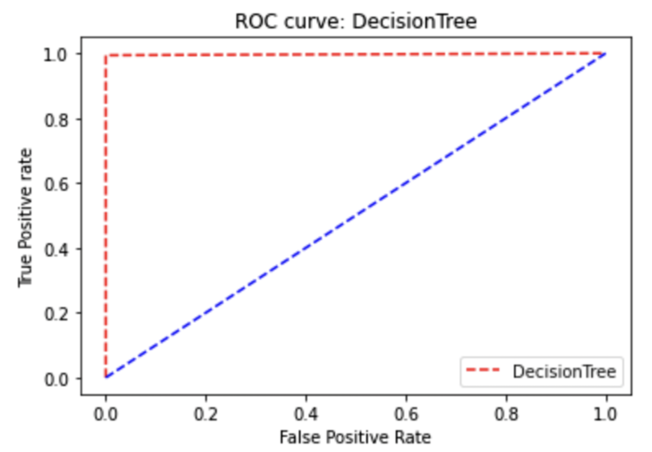
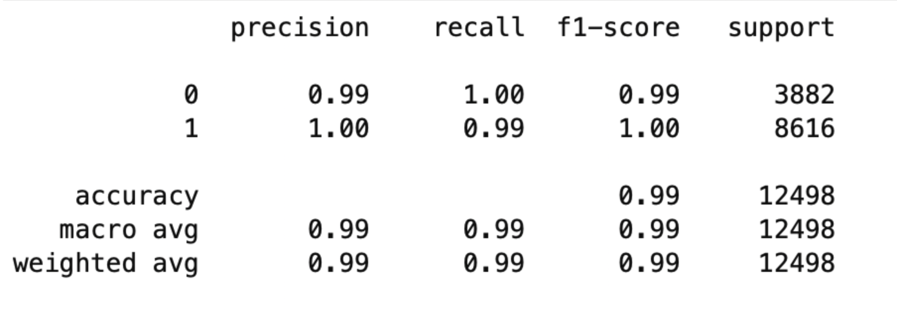
Machine Learning Algorithms
Decision Tree

Slide 6
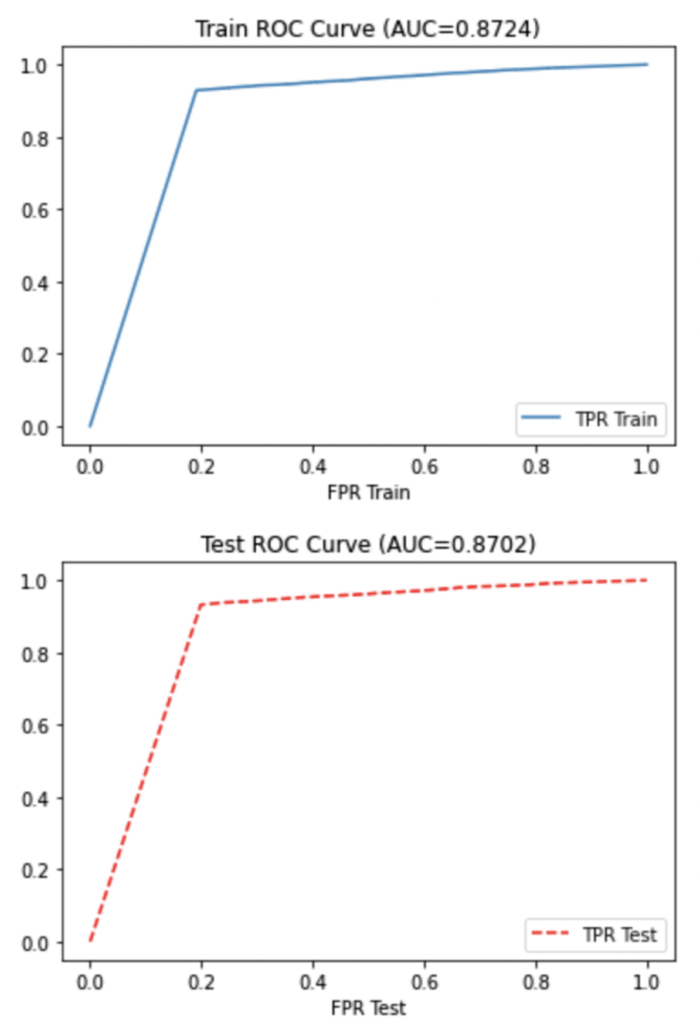
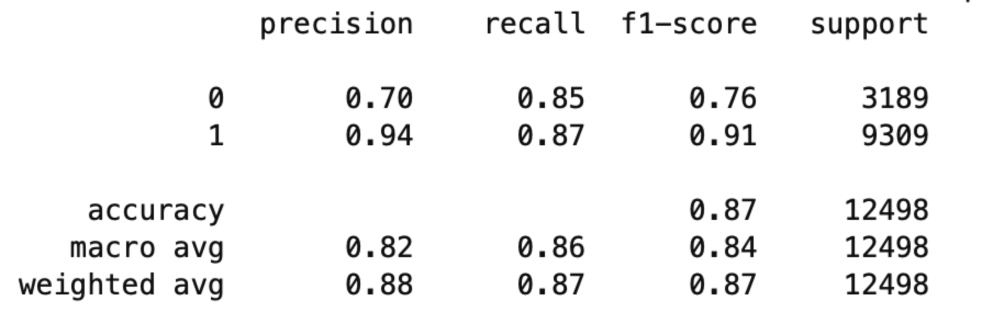
Machine Learning Algorithms
Deep Learning

Slide 7
Streamlit
User Interface to accept user inputs
Validations
Imported the trained model to predict the outcome based on user inputs
Display the prediction

Slide 8
Challenges Faced
Data acquisition - Douglas to add
Using the same Scaler & HotEncoder object on the imported model

Slide 9
Team
Daniel
Douglas
Manpreet
Omar

Slide 10
Demo

